Slide 1
Microservices and Security
Parameswari Ettiappan

Slide 2
What is Microservices
Microservices is a variant of the service-oriented architecture (SOA) architectural style that structures an application as a collection of loosely coupled services.

Slide 3
What is Microservices
In a microservices architecture, services should be fine-grained and the protocols should be lightweight.
The benefit of decomposing an application into different smaller services is that it improves modularity and makes the application easier to understand, develop and test.

Slide 4
What is Microservices
It also parallelizes development by enabling small autonomous teams to develop, deploy and scale their respective services independently.

Slide 5
Three Aspects of microservices

Slide 6
Technical

Slide 7
Architectural

Slide 8
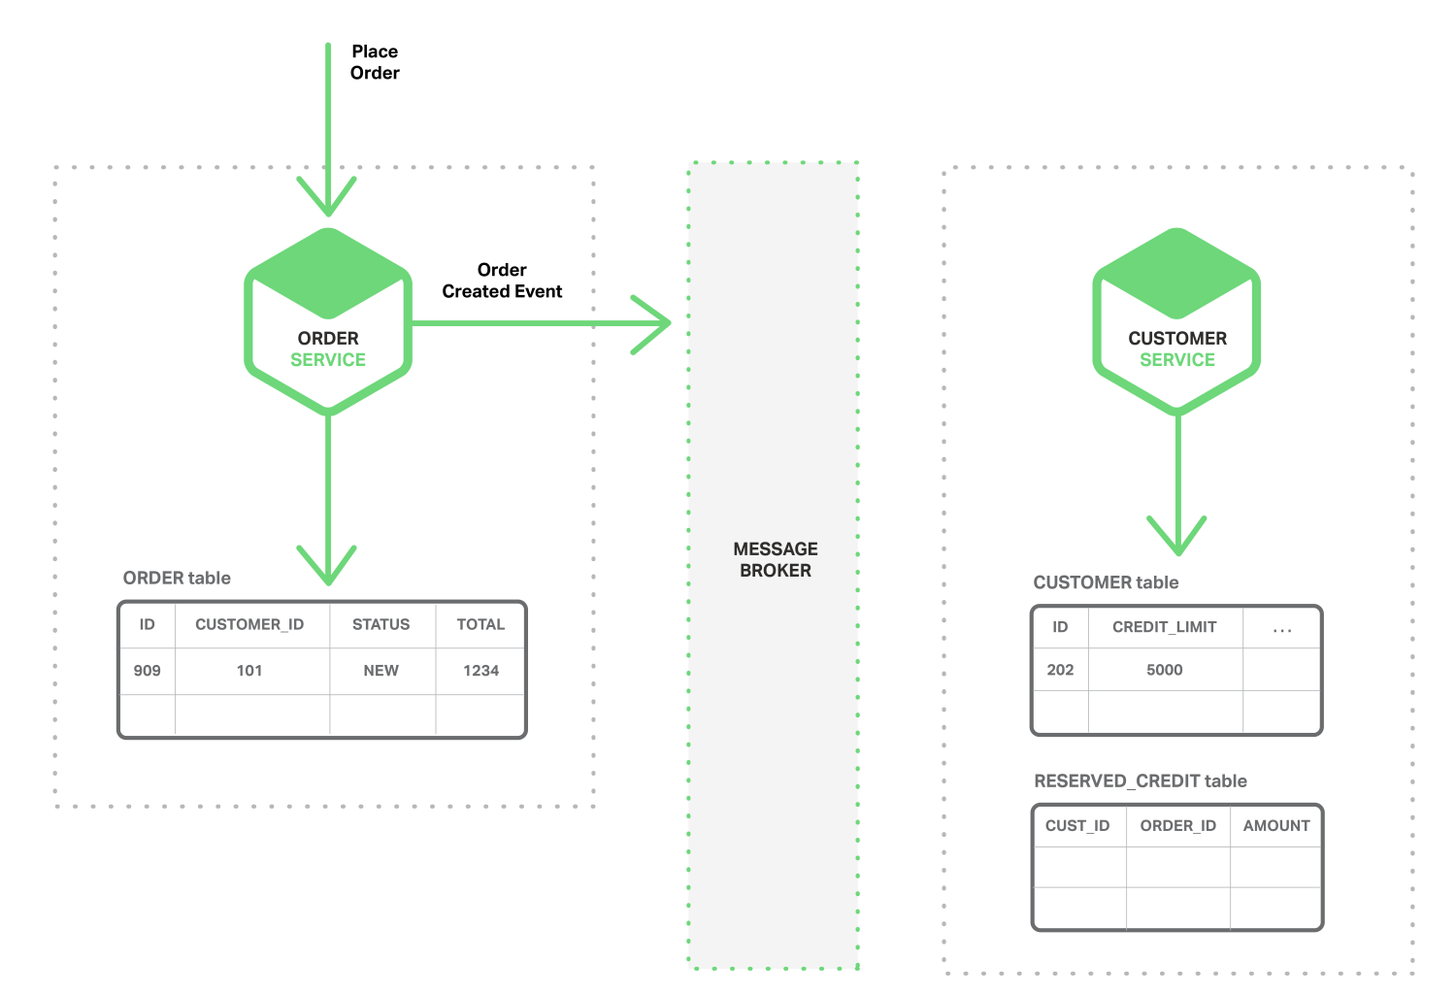

Slide 9
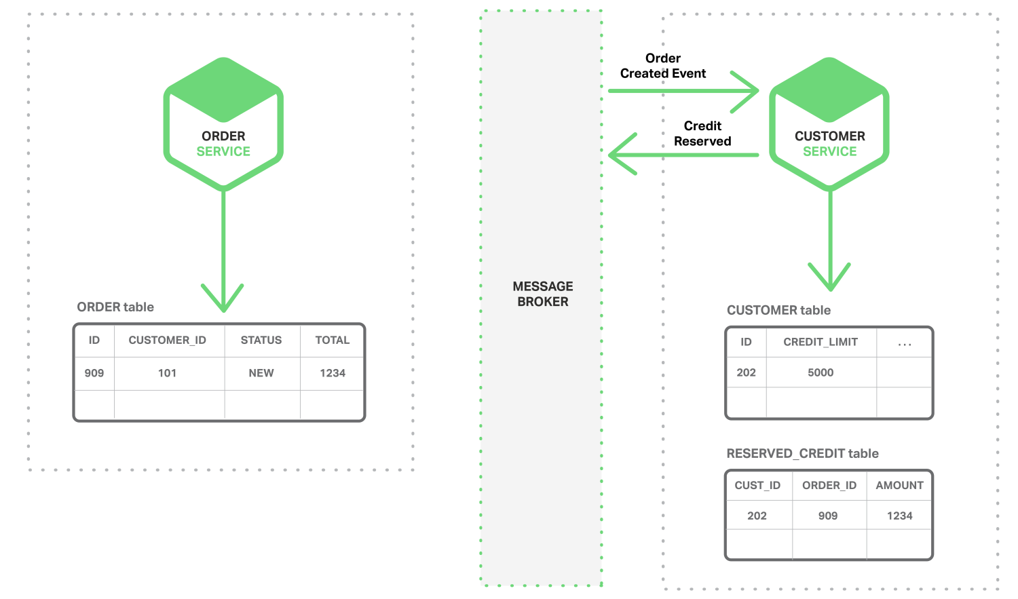

Slide 10
Organizational

Slide 11
Webservices

Slide 12
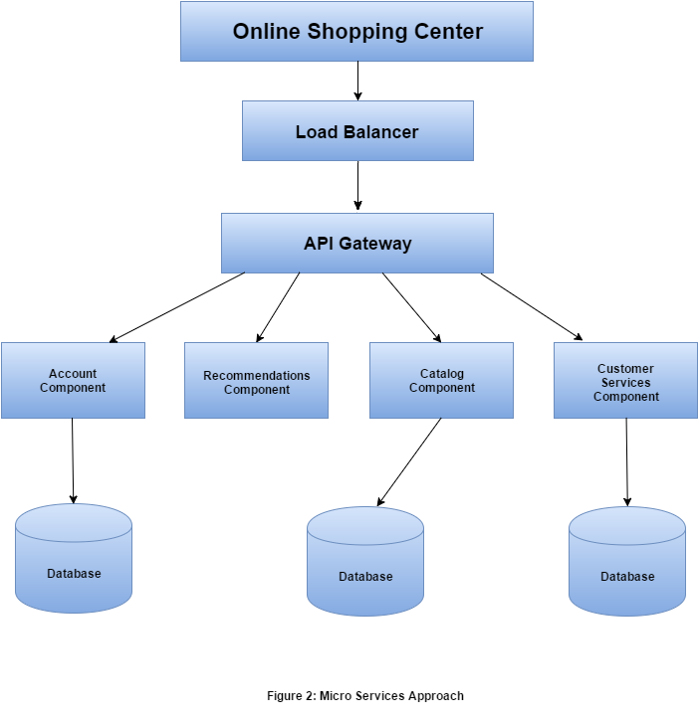
Microservices

Slide 13
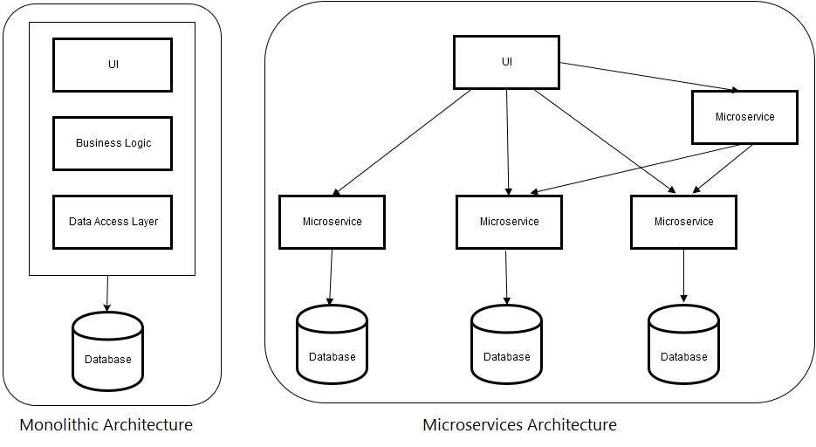

Slide 14
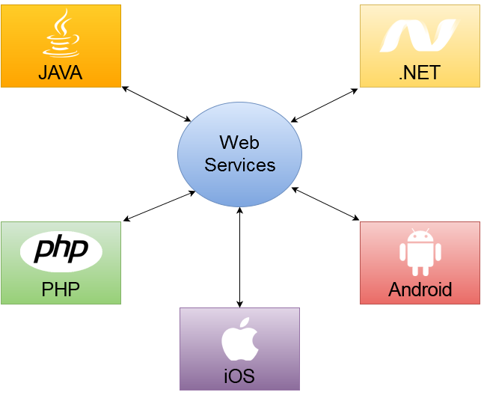

Slide 15
Patterns in Micro services Architecture
API Gateway
Service Registry
Service Discovery

Slide 16
Patterns in Micro services Architecture
API Gateway
Each micro service exposes a set of what are typically fine-grained end points

Slide 17
Patterns in Micro services Architecture
Service Registry
Helps to determine the location of service instances to send request to corresponding services
Netflix Eureka to register service

Slide 18
Patterns in Micro services Architecture
Service Discovery
In monolithic application, service call one another by remote procedure call.
Modern micro services run on VM where the number of instances and their locations change dynamically.
Each Service can be identified through router that are registered with service registry server

Slide 19
Micro services Architecture via Netflix Components
Operations Component | Spring, Netflix OSS
Service Discovery server | Netflix Eureka
Edge Server | Netflix Zuul
Central configuration server | Spring Cloud Config Server
Dynamic Routing and Load Balancer | Netflix Ribbon
OAuth 2.0 protected API’s | Spring Cloud + Spring Security OAuth2
Monitoring | Netflix Hystrix dashboard and turbine

Slide 20
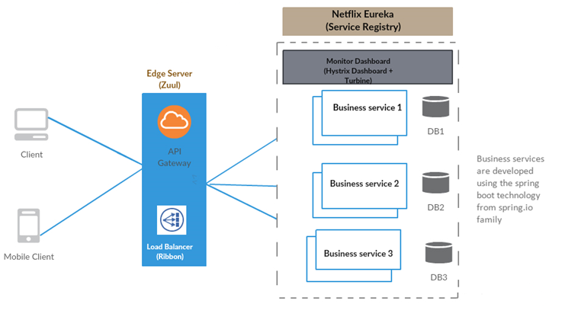

Slide 21
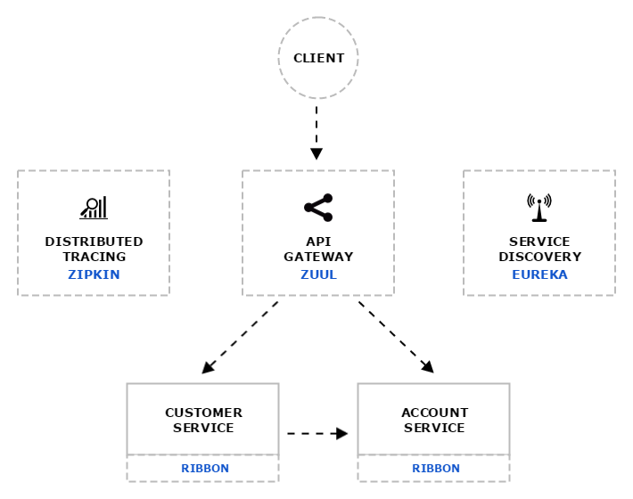
Distributed tracing system with request visualization.
Monitoring, routing and security
client side Load Balancers

Slide 22
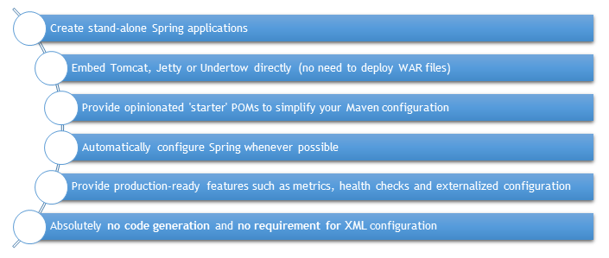
Spring Boot and Microservices

Slide 23
What is Zuul?
Zuul is the front door for all requests from devices and web sites to the backend of the Netflix streaming application.
As an edge service application, Zuul is built to enable dynamic routing, monitoring, resiliency and security.
It also has the ability to route requests to multiple Amazon Auto Scaling Groups as appropriate.

Slide 24
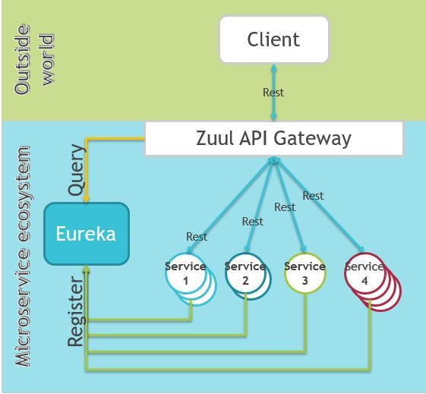
What is Zuul?

Slide 25
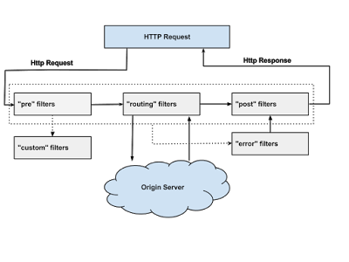

Slide 26
Why did we build Zuul?
The volume and diversity of Netflix API traffic sometimes results in production issues arising quickly and without warning.
We need a system that allows us to rapidly change behaviour in order to react to these situations.

Slide 27
Zuul Filetrs
Authentication and Security – identifying authentication requirements for each resource and rejecting requests that do not satisfy them.

Slide 28
Zuul Filetrs
Insights and Monitoring – tracking meaningful data and statistics at the edge in order to give us an accurate view of production.

Slide 29
Zuul Filetrs
Dynamic Routing – dynamically routing requests to different backend clusters as needed.

Slide 30
Zuul Filetrs
Stress Testing – gradually increasing the traffic to a cluster in order to gauge performance.

Slide 31
Zuul Filetrs
Load Shedding – allocating capacity for each type of request and dropping requests that go over the limit.

Slide 32
Zuul Filetrs
Static Response handling – building some responses directly at the edge instead of forwarding them to an internal cluster

Slide 33
Zuul Filetrs
Multiregion Resiliency – routing requests across AWS regions in order to diversify our Elastic Load Balancer usage and move our edge closer to our members

Slide 34
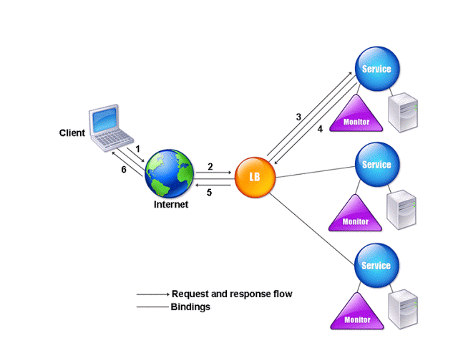
RIBBON LOAD BALANCER

Slide 35
RIBBON LOAD BALANCER
Ribbon is a client-side load balancer, which gives you a lot of control over the behavior of HTTP and TCP clients.
Ribbon's Client component offers a good set of configuration options such as connection timeouts, retries, retry algorithm (exponential, bounded back off) etc.
Ribbon comes built in with a pluggable and customizable Load Balancing component.

Slide 36
RIBBON LOAD BALANCER
Some of the load balancing strategies offered are listed below:
Simple Round Robin LB
Weighted Response Time LB
Zone Aware Round Robin LB
Random LB

Slide 37
RIBBON LOAD BALANCER
Ribbon provides the following features:
Load balancing
Fault tolerance
Multiple protocols (HTTP, TCP, UDP) support in an asynchronous and reactive model
Caching and batching

Slide 38
ELB
Elastic Load Balancing automatically distributes incoming application traffic across multiple Amazon EC2 instances.
It enables you to achieve fault tolerance in your applications, seamlessly providing the required amount of load balancing capacity needed to route application traffic.

Slide 39
ELB
Elastic Load Balancing offers two types of load balancers that both feature high availability, automatic scaling, and robust security.
Classic Load Balancer that routes traffic based on either application or network level information.
Application Load Balancer that routes traffic based on advanced application level information that includes the content of the request.

Slide 40
ELB
The Classic Load Balancer is ideal for simple load balancing of traffic across multiple EC2 instances, while the Application Load Balancer is ideal for applications needing advanced routing capabilities, microservices, and container-based architectures.
Application Load Balancer offers ability to route traffic to multiple services or load balance across multiple ports on the same EC2 instance.

Slide 41
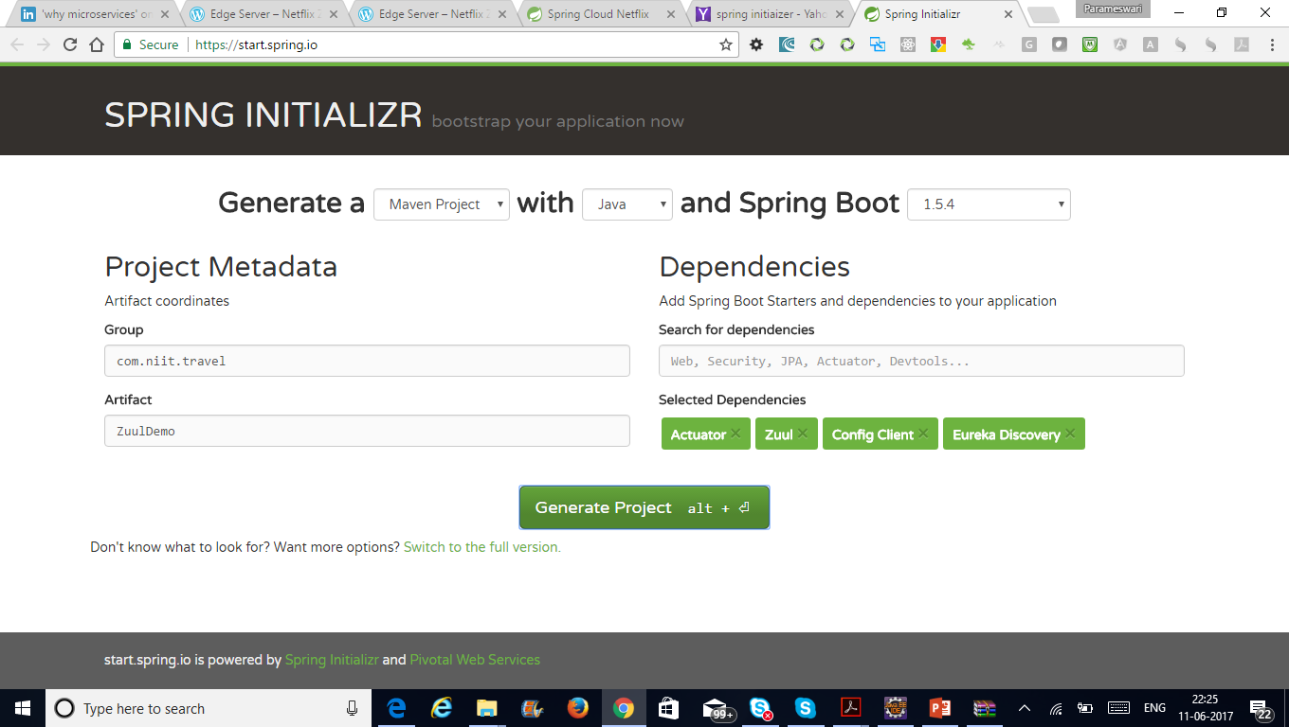

Slide 42

Docker
Docker is an open-source project that automates the deployment of applications inside software containers.
It is promoted by the company Docker, Inc.
Docker provides an additional layer of abstraction and automation of operating-system-level virtualization on Windows and Linux.

Slide 43
Docker vs VM
In a way, Docker is a bit like a virtual machine.
But unlike a virtual machine, rather than creating a whole virtual operating system, Docker allows applications to use the same Linux kernel as the system that they're running on
Only requires applications be shipped with things not already running on the host computer.
This gives a significant performance boost and reduces the size of the application.

Slide 44
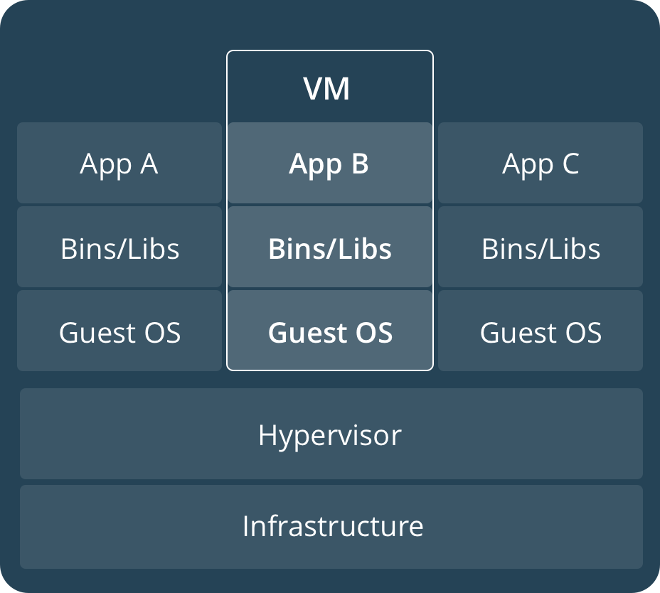
VM

Slide 45
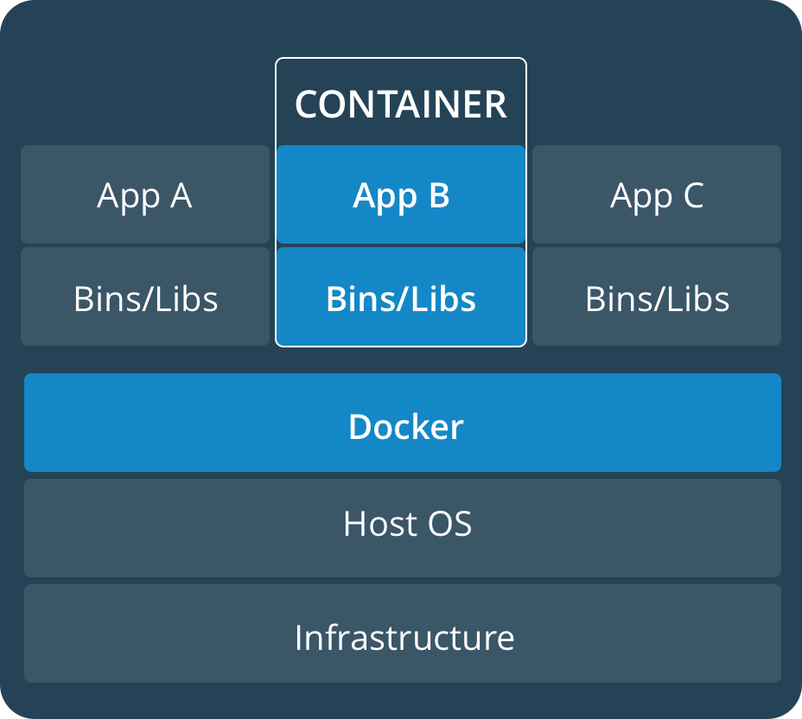
Container

Slide 46
Who is Docker for?
Docker is a tool that is designed to benefit both developers and system administrators, making it a part of many DevOps (developers + operations) toolchains.

Slide 47
Who is Docker for?
For developers, it means that they can focus on writing code without worrying about the system that it will ultimately be running on.
It also allows them to get a head start by using one of thousands of programs already designed to run in a Docker container as a part of their application.

Slide 48
Who is Docker for?
For operations staff, Docker gives flexibility and potentially reduces the number of systems needed because of its small footprint and lower overhead.

Slide 49
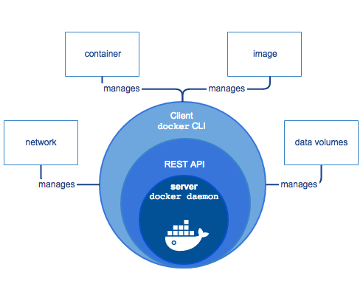

Slide 50
Docker Engine
Docker Engine is a client-server application with these major components:
A server which is a type of long-running program called a daemon process (the dockerdcommand).
A REST API which specifies interfaces that programs can use to talk to the daemon and instruct it what to do.
A command line interface (CLI) client (the docker command).

Slide 51
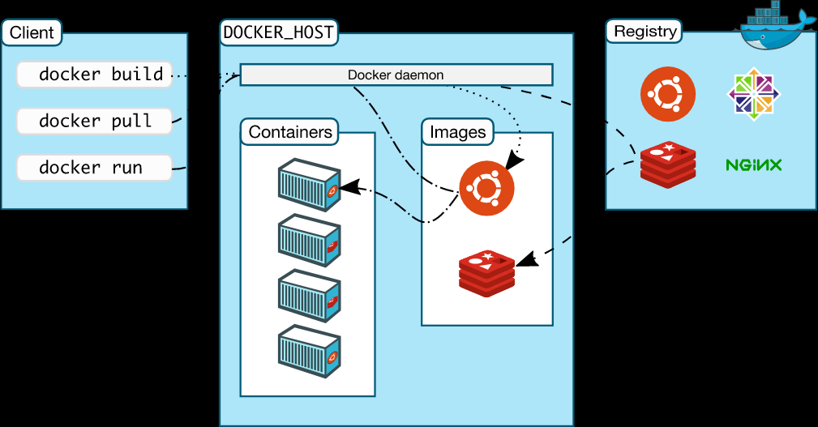
Docker architecture

Slide 52
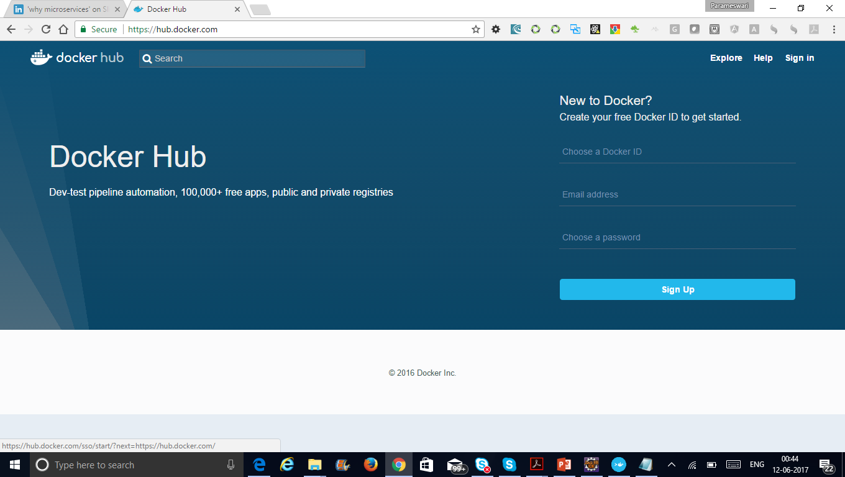
Docker Hub

Slide 53
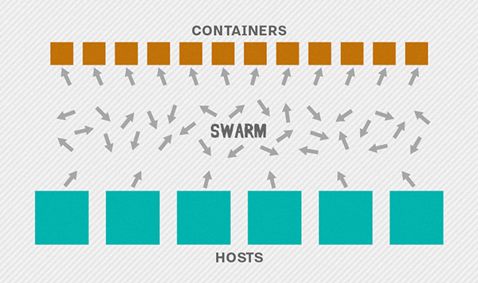
Docker Swarm

Slide 54
Docker Swarm
Cluster management integrated with Docker Engine
Decentralized design
Multi-host networking
Service discovery

Slide 55
Communication Patterns
API Gateway
Partial Failure
Circuit Breaker

Slide 56
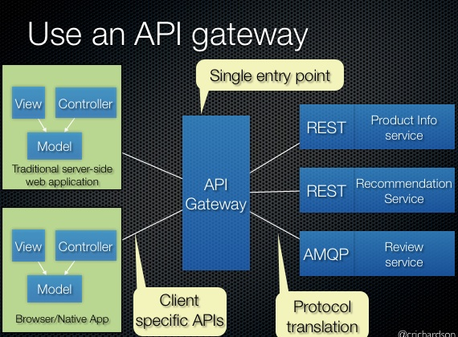
API Gateway

Slide 57
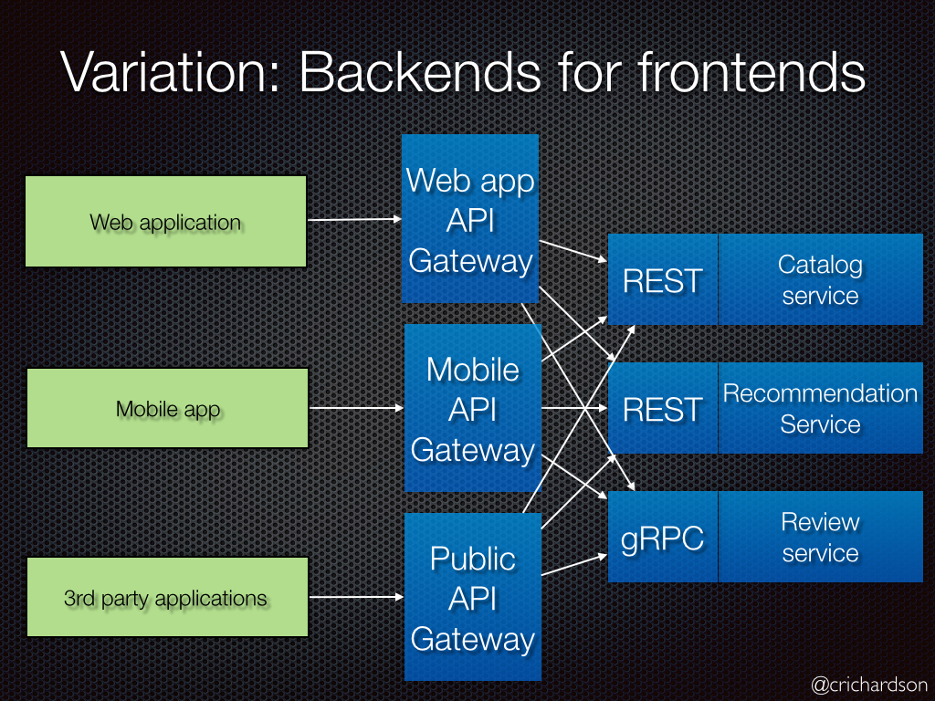
API Gateway

Slide 58
Circuit Breaker Pattern
Apply the Circuit Breaker pattern
Netflix’s Hystrix library provides an implementation of the Circuit Breaker pattern:
when we apply a circuit breaker to a method, Hystrix watches for failing calls to that method, and if failures build up to a threshold, Hystrix opens the circuit so that subsequent calls automatically fail.
While the circuit is open, Hystrix redirects calls to the method, and they’re passed on to our specified fallback method.

Slide 59
Event Driven Architecture

Slide 60
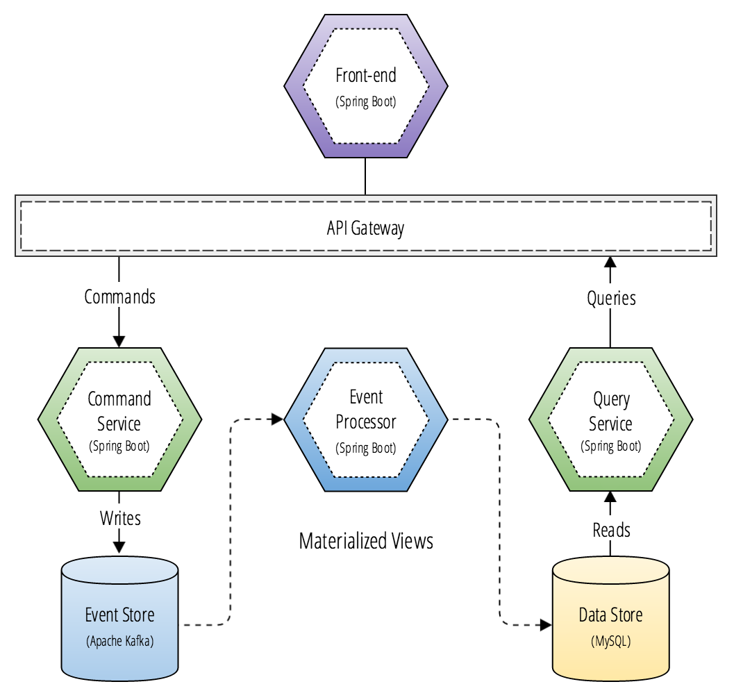
CQRS(Command Query Responsibility Segregation) and Micro services

Slide 61
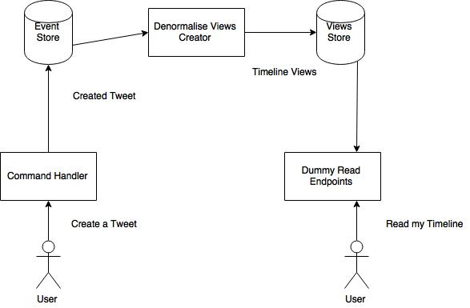
CQRS and Event Sourcing

Slide 62
Microservices Security
Kerckhoff’s Principle
Stated simply, the security of a cryptosystem should depend solely on the secrecy of the key. a cryptosystem should be secure even if everything about the system, except the key, is public knowledge.

Slide 63
Microservices Security
Claude Shannon Principle
The enemy knows the system.

Slide 64
Security through obscurity
An example of security by obscurity is when someone has an expensive house outfitted with the latest alarm system, but they keep the key and alarm code in the planter box next to the front door.
This is security by obscurity because if anyone knows the secret, i.e. that the key and code are stored in the planter, then the security of the entire system is compromised.

Slide 65
General Security Considerations
Are you just protecting your system at the Internet boundary?
What protections do you have in place if an intruder gets inside your core network?
How easily could someone inside your network get access to the traffic between your services?
Do your services trust each other too much?
When your service is called, does it require the calling software to authenticate itself, or does it let anything connect?

Slide 66
General Security Considerations
Do your services let their callers access all the APIs that a service offers, or just the ones it needs to fulfil its function?
Does the identity of the person who originated each call at the client get passed into your internal services, or is that lost at the gateway?
Can your services request any data from each other, or only the data of a user that has given their authority?

Slide 67
General Security Considerations
If an attacker owned a service, could they pretty easily request anything from its downstream services?
What guarantees do you have that a request received from an authenticated user hasn’t been tampered with? (Tamper-Proofing)
How do you ensure that an authorised request, delivered a second time, is detected and rejected? (Replay Protection)
Are you up to speed with the state of the art in password storage? (Password Storage)

Slide 68
General Security Considerations
Do you realise that, if your password database is stolen, simply salted hashes are completely useless these days? (Password Storage)
How do you actively identify the private and sensitive data in your database? (Promoting Privacy)
If your data gets stolen, what protections do you have in place to prevent the most sensitive parts from being readable? (Private & Sensitive Data)

Slide 69
General Security Considerations
If your services are using private keys, how do you protect those keys from being used by an intruder? (Key Management, Never assume that your secrets are safe)
Do you know what a Hardware Security Module (HSM) is, and when and how to make use of one?
What logging do you have in place that you can use to detect and analyse security breaches?

Slide 70
Middleware
Do you share a single database login across all your services?
How much data do your services have access to? All of it? Or only what they need? (Least Privilege)
Do your DB authorisation policies allow updates and deletes to tables that the application only ever inserts into?
Does your messaging middleware even have login credentials?
Do your services have access to all messages in your system, or only the ones they need to see?

Slide 71
Middleware
If an attacker got hold of one service’s messaging credentials, how much data could they get access to?
If an attacker got hold of one service’s messaging credentials, what operations could they initiate? (Least Privilege)
If you’re protecting your database and messaging with login credentials, how are you protecting the credentials? (Never assume that your secrets are safe)
How might the legacy systems in your architecture put other services at risk? (Securing the weakest link)

Slide 72
Edge Services
Have you upgraded your TLS implementations to the latest versions possible?
Have you configured TLS to eliminate downgrade and weak cipher attacks?
Who on your staff knows everything about TLS and how to configure it safely?
How do you ensure your internal websites and admin URLs aren’t accidentally opened up
I have a list of cracked passwords and user emails. Could I use your password reminder URL to test which users are in your system?

Slide 73
Edge Services
Does the rest of your system trust your gateway services too much? (Reluctance to Trust)
If you assume that your gateway services have been fully breached, what would you do differently elsewhere? (Defence in Depth)
If your gateway services were fully breached, what data could be gleaned from memory? (Defence in Depth)
If your gateway services were fully breached, what data could be captured from the network traffic? (Defence in Depth)

Slide 74
Web & Other Clients
How are you helping your users to choose safer passwords? (Password complexity)
When a password is entered wrong, what feedback do you give? Could it be used to enumerate user accounts? (Enumeration)
Do you lock an account after some number of failed login attempts? (Authentication)
How many chances do you give an attacker to guess the password on each account? (Account Security)
When you lock an account, what feedback do you give? Could it be used to enumerate user accounts? (Enumeration)

Slide 75
Web & Other Clients
How are you helping your users to choose safer passwords? (Password complexity)
When a password is entered wrong, what feedback do you give? Could it be used to enumerate user accounts? (Enumeration)
Do you lock an account after some number of failed login attempts? (Authentication)
How many chances do you give an attacker to guess the password on each account? (Account Security)
When you lock an account, what feedback do you give? Could it be used to enumerate user accounts? (Enumeration)

Slide 76
Web & Other Clients
Has anyone else noticed there seems to be an epic battle between security and good User Experience? (UX vs Security)
Are you familiar with the OWASP Top Ten web vulnerabilities? (Web Security Flaws)
Could you name all of the OWASP Top Ten web vulnerabilities? (Web Security Flaws)
Could everyone on your team name all of the OWASP Top Ten? (Web Security Flaws)
Could everyone on your team explain how to protect against all of the OWASP Top Ten? (Web Security Flaws)
How do you ensure that every piece of user data is properly escaped when used as output? (XSS / Output Encoding)

Slide 77
Web & Other Clients
How are you helping prevent your users from getting attacked as a result of using your web app?
Does your web app design treat the browser as an insecure environment? (Reluctance to Trust)
Does your native mobile app design treat the device as an insecure environment? (Reluctance to Trust)
How are you helping prevent your users from getting attacked as a result of using your native app?
What data are you storing or caching on the client? How are you protecting it? What could happen if someone stole it? Does it need to be there at all?

Slide 78
People & Process
What are you doing to ensure security is baked into everything your engineering team does? (Build Security In)
How do you burn common security principles into everyone’s brains? (Security Principles)
What security activities are explicitly built into your development process? (Secure Software Development Process)
What security training do you provide for your developers, testers and operations staff? (Security Training)
Do tech staff just know the names of vulnerabilities, or do they actually know how to exploit & test them? (Security Training)
What controls have you put around who can access which parts of your system? (Access Control)

Slide 79
People & Process
What’s your plan for regularly reviewing the appropriateness of those controls and people’s access? (Access Control Review/Audit)
What’s your process for discovering and remediating vulnerabilities in 3rd party software? (Vulnerability Management)
How do you encourage engineers to dedicate time to brainstorming the risks in your systems? (Risk Brainstorming / “Risk-storming”)
Do you have service templates that ensure every new service starts off with great security? (Secure Application Templates)
What’s your plan for getting internal staff regularly testing the security of your systems? (Security Testing)
What’s your plan for how often you’ll bring in external security experts, and how you’ll choose what they focus on? (Security Testing)

Slide 80
People & Process
What activities do you get expert help with? Just penetration testing? How about design and architecture reviews? (Security Testing)
What automated tests do you have to catch vulnerabilities as they’re written? (Automated Security Testing)
What automated tests do you have to ensure security controls are always in place? (Automated Security Testing)
Are you constantly asking yourselves: “What if this control fails? What’s the next control?” (Defence in Depth)

Slide 81
Security Best Practices
1. Use OAuth for user identity and access control
Use 'defence in depth' to prioritize key services
Don’t write your own crypto code
use NaCl/libsodium for encryption
Use automatic security updates
Use a distributed firewall with centralized control
Get your containers out of the public network
Monitor everything with a tool

Slide 82
Security Best Practices
Built originally by engineers at SoundCloud, Prometheus is an open source monitoring platform and a part of the Cloud Native Computing Foundation.

Slide 83
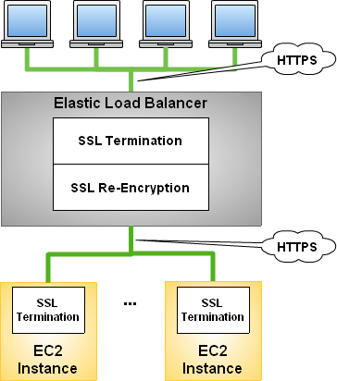
Securing Your Microservices via Bi-Directional TLS

Slide 84
JSON Web Token (JWT)
JSON Web Token or JWT is one of the popular token format used for web applications and web service APIs for authentication nowadays.
It is a open standard defined in RFC 7519 .

Slide 85
Structure of JWT
Basically the token has three parts separated by dots(.), following are the denotes the parts:
Header
Payload
Signature

Slide 86
Header
{
"alg": "HS256",
"typ": "JWT"
}
The Base64 encoded string of the above header JSON is :
eyJhbGciOiJIUzI1NiIsInR5cCI6IkpXVCJ9

Slide 87
Payload
Registered Claims
Public Claims
Private Claims

Slide 88
Registered Claims
exp: Expiration Value(Type: Number – DateTime). This is commonly used one by the most of the issuer. It has a numeric value that denotes a time interval. The token will expire after this time interval from the current time.
iss: Issuer (Type: String or URI)
sub: Subject (Type: String)
aud: Audience (Type: String or URI)
nbf: Not Before (Type: Number – DateTime). Denotes the numeric value of time before which the token must not be accept for processing.
iat: Issued At (Type: Number – DateTime). It denotes the numeric format of issued data and time.
jti: JWT ID (Type: String). It is the unique identifier for the JWT token.

Slide 89
Public Claims
The user defined data fields carry application related informations like name. These type of fields are called public claims.

Slide 90
Private Claims
We can also use our custom fields in the payload.
The fields added by user for improving information interchange is called the Private Claims.
The parties should agree for using them.

Slide 91
Signature
The final part of the JWT is the signature.
It is created by hashing the Header, Payload and secret. If our secret is secret then the signature is a hash of the concatenated base64 encoded header and payload with dot (.):
Usually the server will give the JWT token to corresponding client application after a successful authentication. Preparing of the JWT token could be done by server application. The method hashUsingSHA256 encode the concatinatedString with the secret key in the server side.

